Slide 1
Life Cycle of a Butterfly!
Next

Slide 2
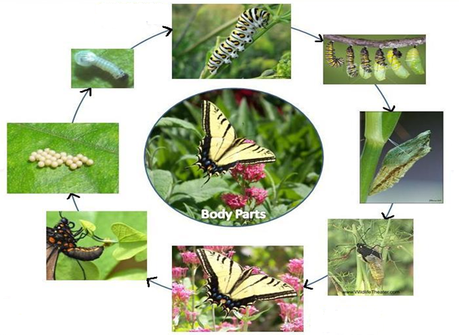
The Butterfly Lifecycle
2. Larva
Click Me !
1. Egg
Click Me !
Click Me !
3. Pupa
Click Me !
4. Adult
Picture taken from: http://shelledy.mesa.k12.co.us/staff/computerlab/Butterfly_home.html

Slide 3
The Butterfly Lifecycle
1. Egg: Adult female butterflies lay their eggs on plants. The eggs can be different shapes and sizes depending on the type of butterfly.
2. Larva: (Caterpillar) eat a lot and keep the food for storage for when it goes into the pupa. Larva shed their skin 4 to 5 times and grow 100 times their initial size during this stage.
Next
Return to Lifecycle

Slide 4
The Butterfly Lifecycle
3. Pupa: (Chrysalis) is formed around the caterpillar when they reach their maximum length and weight. In the pupa, the caterpillar grows tissue, internal organs, and limbs. This stage lasts several weeks to a few months.
4. Adult: The butterfly is done growing at this stage. Within a few hours, it learns to fly and begins to search for a mate. Butterflies live 1 to 2 weeks.
Next
Return to Lifecycle

Slide 5
The Very Hungry Caterpillar
Watch video on YouTube
Return to Start

